Slide 1
Distributed Operating Systems (CS 30009)
UNIT_I_Lecture_4

Slide 2
Design Issues
To build a distributed system, the users must deal with the following design issues:
Transparency:
A transparency is some aspect of the distributed system that is hidden from the user (programmer, system developer, user or application program).
A transparency is provided by including some set of mechanisms in the distributed system at a layer below the interface where the transparency is required.
Types of transpariencies:
Location transparency: refers to the fact that in a true distributed system, users cannot tell where hardware and software resources such as CPUs, printers, files, and databases are located.
The name of the resource must not secreatly encode the location of the resource, so names like machine1: prog.c is not acceptable.

Slide 3
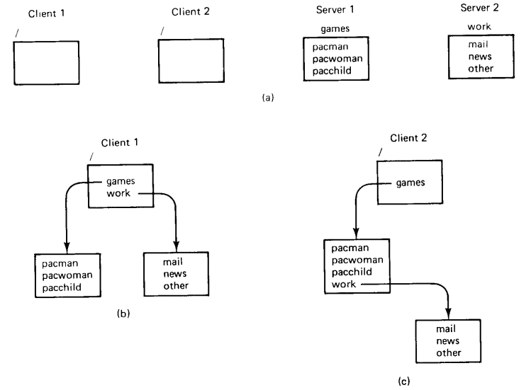
Cont..
Migration transparency: meanse that the resources must be free to move from one location to another whithout having their names change.
The above figure shows how the files games and work of Server1 and Server2 respectively are mounted at Client1 and Client2.

Slide 4
Cont..
Since a path like /work/news does not reveal the location of the server, therefeore it is location transparent.
Now suppose that the administrators running the servers decide that reading network news really falls in the category “games” rather than in the category “work”. Accordingly, they move news from Server2 to Server1.
The next time Client1 boots and mounts the severs in the same way as done earlier, he will notice that /work/news no longer exists. Instead, there is a new entry /games/news.
Hence, if a file or directory has migrated from one server to another has forced it to acquire a new name then that file or directory is not location transparent.
Replication Transparency:
Replication transparency ensures that clients interact with a set of replicated resources as if they were a single resource. It hides the presence of replicas and manages consistency among them.
What happens when two or more users try to update the same file at the same time? If the system is Concurrency transparent, the users will not notice the existence of other users.

Slide 5
Cont..
One method of achieveing this form of transparency would be for the system to lock a resource automatically once somone has started to use it, unlocking it only when the access will be finished.
Parallelism transparency - Activities can happen in parallel without users knowing.
For example: A programmer knows that his DS has 1000 CPUs and he want to use a substantial fraction of them for a chess program that evaluates boards in parallel.
Flexibility:
The second key design issue is flexibility.
A flexible distributed system can be configured to provide exactly the services that a user or programmer needs.
A system with this kind of flexibility generally provides a number of key properties.
Extensibility: allows one to add or replace system components in order to extend or modify system functionality.
Openness: means that a system provides its services according to standard rules regarding invo-cation syntax and semantics. Openness allows multiple implementations of standard components to be produced.
The openness of the distributed system determined primarily by the degree to which new resource-sharing services can be made available to the users.

Slide 6
Cont..
Interoperability: ensures that systems implementing the same standards (and possibly even those that do not) can interoperate.
An important concept with regards to flexibility is the separation of policy and mechanism.
A mechanism provides the infrastructure necessary to do something while a policy determines how that something is done.
For example, a distributed system may provide secure communication by enabling the encryption of all messages. A system where policy and mechanism is not separated might provide a single hardcoded encryption algorithm that is used to encrypt all outgoing messages. A more flexible system, on the other hand, would provide the infrastructure (i.e., the mechanism) needed to call an arbitrary encryption routine when encrypting outgoing messages. In this way the user or programmer is given an opportunity to choose the most appropriate algorithm to use, rather than a built-in system default.

Slide 7
#8.2 Monolithic kernel Vs Microkernel
Monolithic Kernel
Microkernel
Traditional kernel that provides most services itself.
It is less flexible
Centralized OS, augmented with networking facilities and integration of remote services
The system calls trap the kernel
Own disks and local files
DOS that are extension of UNIX OS use this approach
Eg. Sprite OS
Kernel should provide as little as possible; bulk services available from user level servers.
It is more flexible & highly modular
It provides four services – IPC, Memory mgmt., Process mgmt. and scheduling, Low-level I/O
It does not provide the file system, directory system, process mgmt.,
Other services are user level service
It is highly modular
Eg. Amoeba OS

Slide 8
Cont..
Reliability:
The next design issue is reliability.
One of the original goal of building DS was to make them more reliable than uniprocessor system.
The idea is that if a machine goes down, some other machine takes over the job.
Availability of a system is defined as the fraction of time that the system is usable.
Tool to improve availability is redundancy – i.e. keep h/w and s/w replicas, so that if one of them fails the other will take over its place
A highly reliable system must be highly available, but that is not enough. No data loss, not grabled, consistent across, security, protection from unauthorized access
System should be fault tolerance (Capability to mask failures)
All the separate services should be arranged in such a manner that it should not add substantial overhead to the system.

Slide 9
Cont..
Performance:
Response Time
Throughput
System utilization
Network capacity consumed
Communication overhead dwarfs the extra CPU cycles gained
Fine-grained parallelism (Large number of small computations)
Coarse-grained parallelism (Large computations, low interaction rates, and little data)
Cost time

Slide 10
Cont..
Scalability:
The next design issue is scalability.
The Scalable System in Distributed System refers to the system in which there is a possibility of extending the system as the number of users and resources grows with time.
The system should be enough capable to handle the load that the system and application software need not change when the scale of the system increases.
To exemplify, with the increasing number of users and workstations the frequency of file access is likely to increase in a distributed system. So, there must be some possibility to add more servers to avoid any issue in file accessing handling.
Scalability is generally considered concerning hardware and software.
In hardware, scalability refers to the ability to change workloads by altering hardware resources such as processors, memory, and hard disc space.
Software scalability refers to the capacity to adapt to changing workloads by altering the scheduling mechanism and parallelism level.

Slide 11
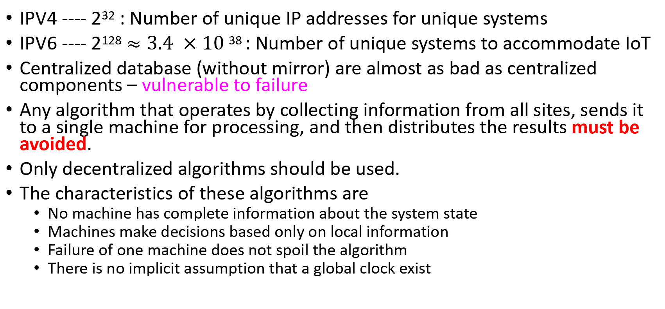
Cont..
IPV4 ---- 2³² : Number of unique IP addresses for unique systems
IPV6 ---- 2¹²⁸ $≈3.4 ×10$ ³⁸ : Number of unique systems to accommodate IoT
Centralized database (without mirror) are almost as bad as centralized components – vulnerable to failure
Any algorithm that operates by collecting information from all sites, sends it to a single machine for processing, and then distributes the results must be avoided.
Only decentralized algorithms should be used.
The characteristics of these algorithms are
No machine has complete information about the system state
Machines make decisions based only on local information
Failure of one machine does not spoil the algorithm
There is no implicit assumption that a global clock exist

Slide 12
# 8.5: Scalability cont.
Netflix's own custom global CDN (Content delivery network)
Distributed GIS technology enables modern online mapping systems (such as Google Maps and Bing Maps), Location-based services (LBS), web-based GIS (such as ArcGIS Online) and numerous map-enabled applications.
Examples of distributed OS are Solaris, AIX, OSF, etc.
Messaging systems like WhatsApp are known as distributed systems. They are designed to operate on a distributed infrastructure, allowing messages to be sent and received across multiple servers and devices.
With AWS High-Performance Computing (HPC), you can accelerate innovation with fast networking and virtually unlimited distributed computing infrastructure.
Facebook uses thousands of distributed systems and microservices to power their ecosystem. In order to communicate with each other, these microservices rely on a message queue. Facebook Ordered Queueing Service (FOQS) is an internal Facebook tool that fills that role.

